Slide 1
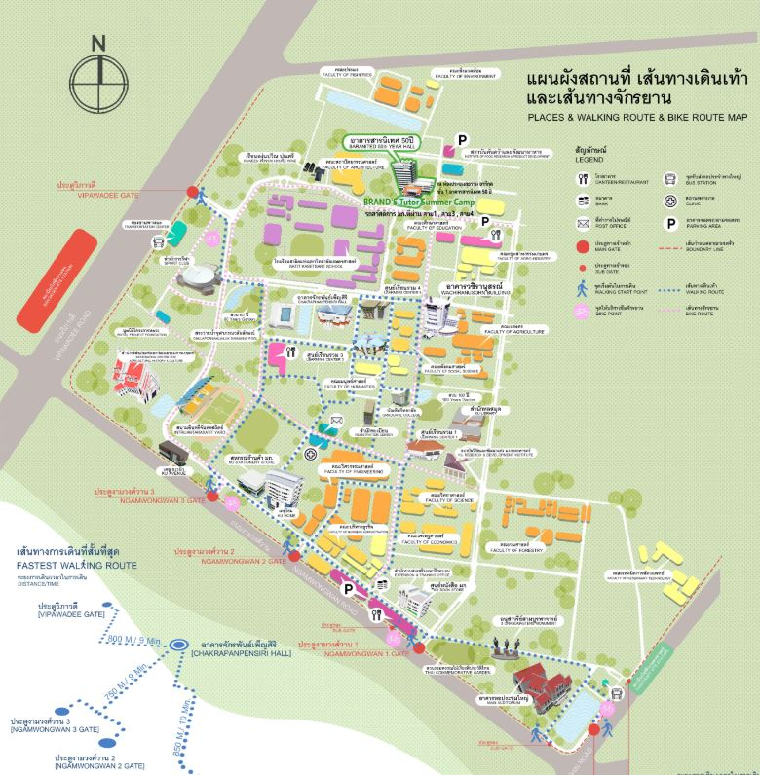
My project : Opportunity to open new restaurant
around Kasetsart University Thailand

Slide 2
Introduction
Everyday people must be eat food , it's basic factors for living .
When i study in university I have seen a lot of restaurant open and close
a lot for 4 years , Now a lot of them still open but if it already have it a lot,
is it still have an opportunity to open new restaurant around university.
so this is my inspiration in my project
"Opportunity to open new restaurant around Kasetsart University Thailand "

Slide 3
Business Problem
I think about business problem and list in question to solve answer .
1. Where is the location for open new restaurant ?
2. What is popular food for student ?
3. How many is restaurant around Kasetsart University ?
4. How many kind of restaurant around Kasetsart University ?

Slide 4
Data
In my project "Opportunity to open new restaurant around Kasetsart University Thailand"
, I think found list of data in below
1.Data number of restaurant around Kasetsart University.
2. Data location restaurant around Kasetsart University .
3. Data number of student in Kasetsart University ( effect to size of restaurant ) .
4. Data kind of popular food from student .
5. Trends of demands food from student .
in above a lot of data i think scout from Foursquare API and outsource.

Slide 5
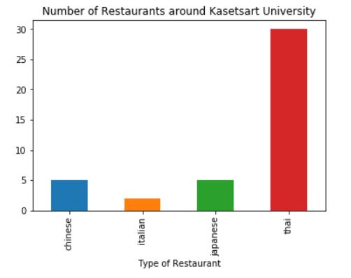
Results
1. Number of restaurant near Kasetsart University
Type food | No.
Chinese | 5
Italian | 2
Japanese | 5
Thai | 30

Slide 6
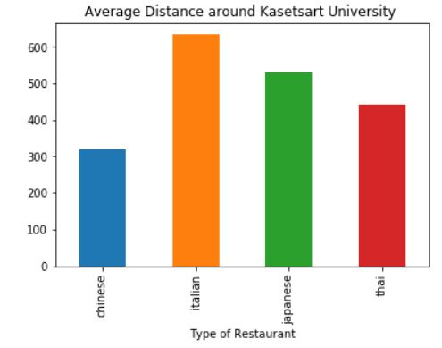
Results
2. Average distance each restaurant
Type food | distance
Chinese | 319
Italian | 633.5
Japanese | 531.4
Thai | 442.5

Slide 7
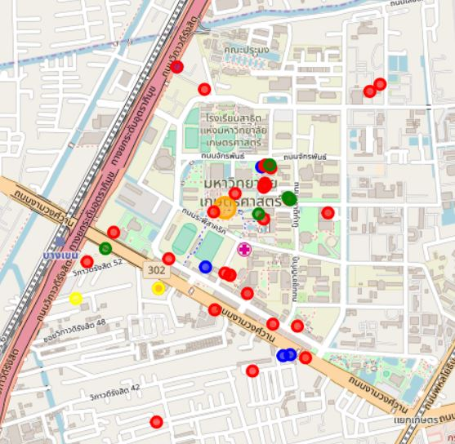
Results
3. Map
Remark
Red | = | Thai
Green | = | Japan
Yellow | = | Italian
Blue | = | Chinese

Slide 8




Conclusion
I see the opertinity in italian restaurant the most because it's have only 2 restaurant (Lower)
near to the Kasetsart university . And average distance from university have more than
any restaurant (Chinese , japan, thai )

Slide 9
THANK YOU

